Slide 1
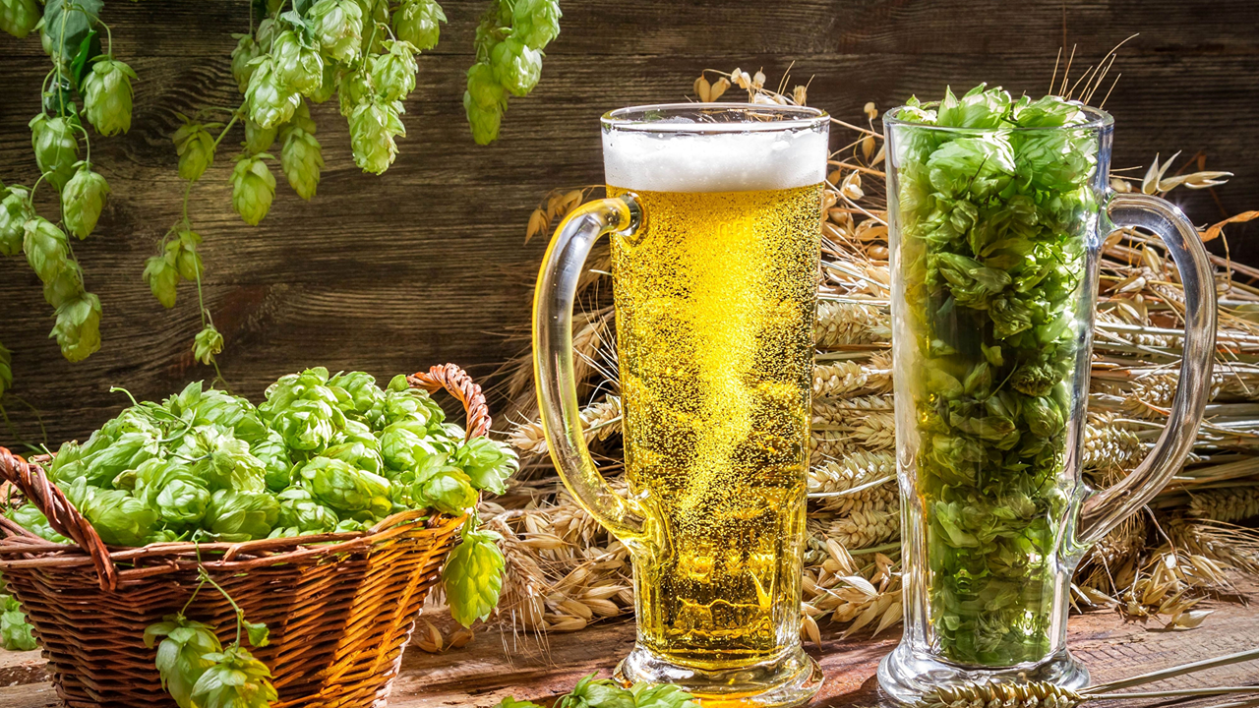
Beer
Jacob Gipson
Tavin Weeda

Slide 2
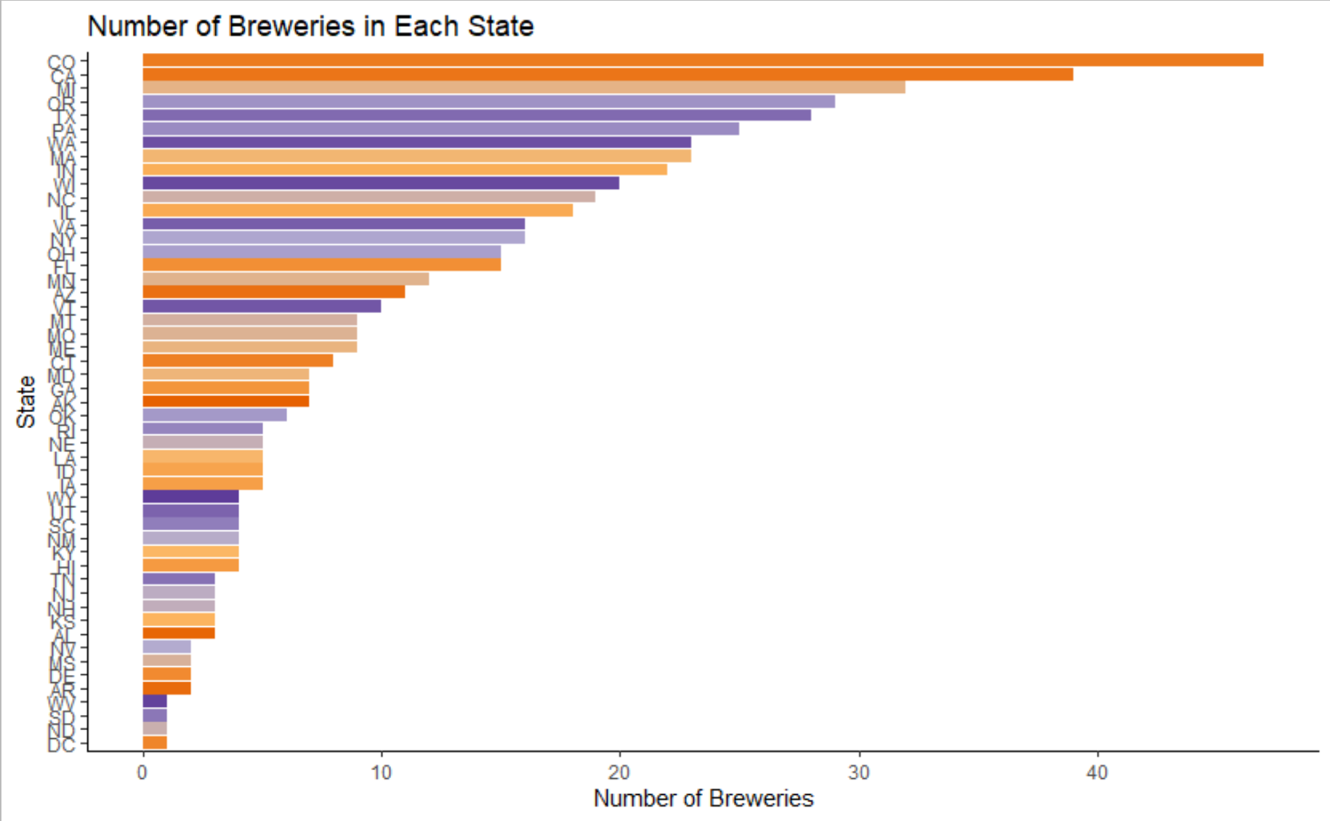


Breweries
47 Breweries
in Colorado

Slide 3
Addressing Missing Values
Beers Missing Style
Missing
IBU and ABV
Replaced missing IBU and ABV with the mean IBU and ABV for each style
3 were not actual beers
2 were found online and input
52 IBU’s were replaced manually based on style

Slide 4
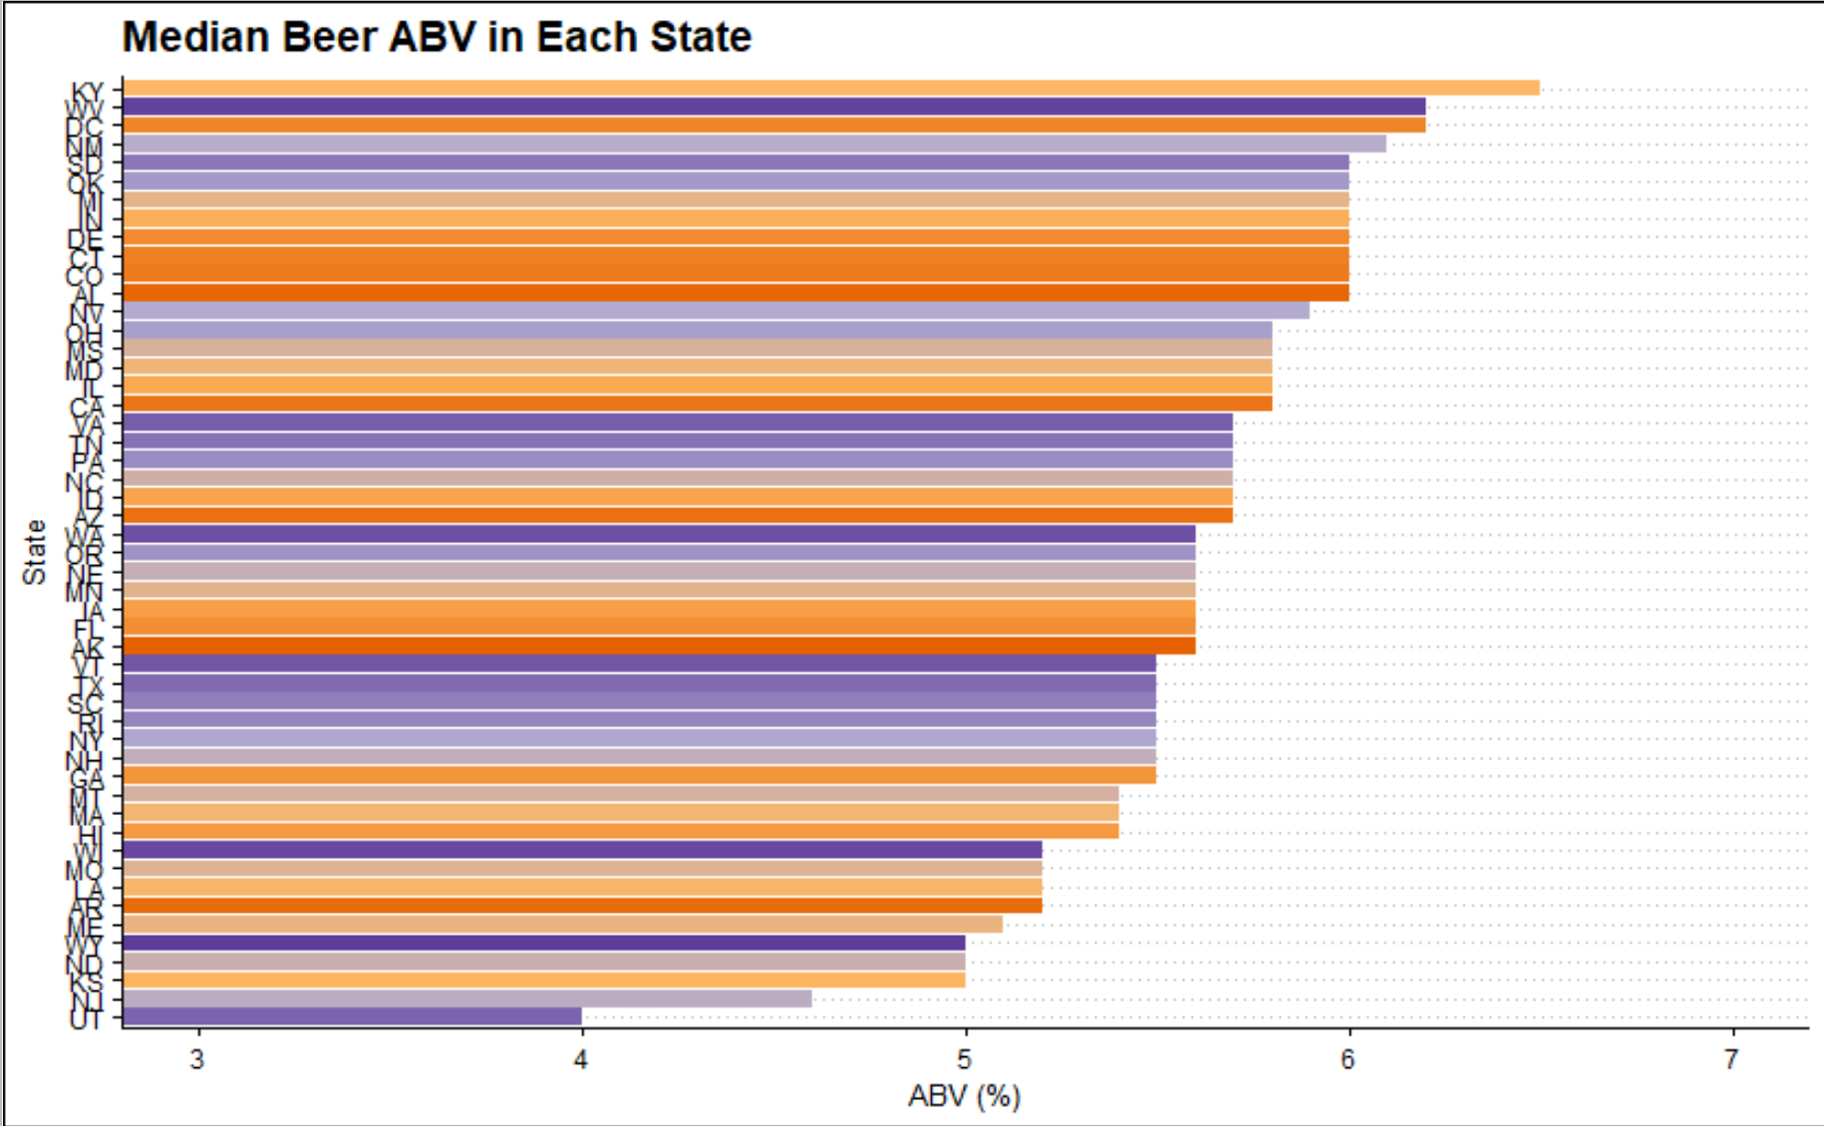
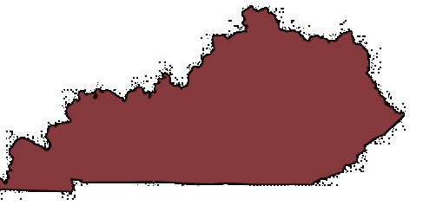
ABV
Kentucky median beer ABV 6.5%

Slide 5
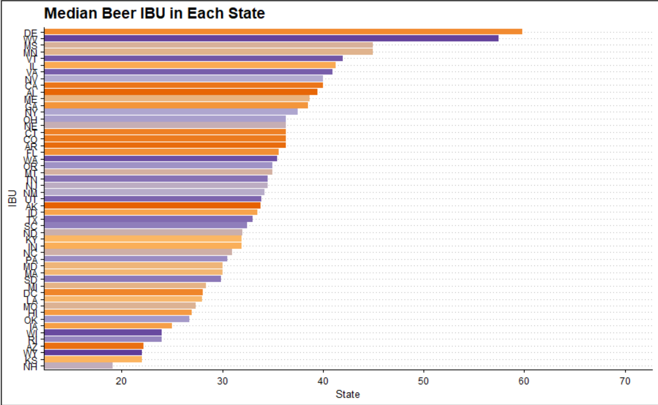

IBU
Delaware Median IBU: 60

Slide 6
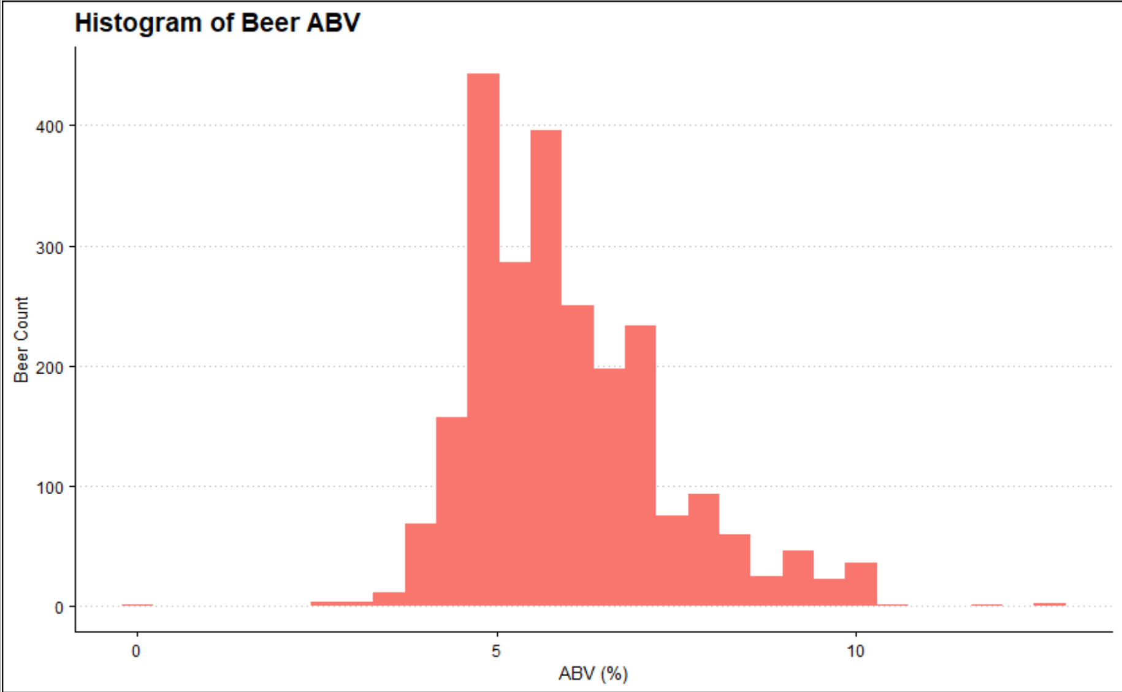
ABV Distribution
Mean: 5.98 ABV
Median: 5.64 ABV

Slide 7
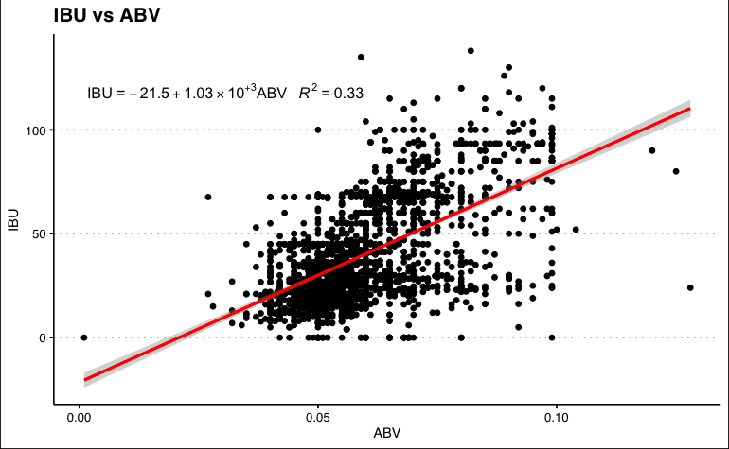
Relationship: ABV vs IBU

Slide 8
Classifying Ales and IPA’s
We wanted to classify beers as IPA’s and Pale Ales based on their ABV and IBU values
To do so we had to tune a knn model to classify our beers.
We split our data into a training set and a validation set.
We built our model to the training set and evaluated its performance using the validation set
We tuned our k parameter using both external and internal cross validation

Slide 9
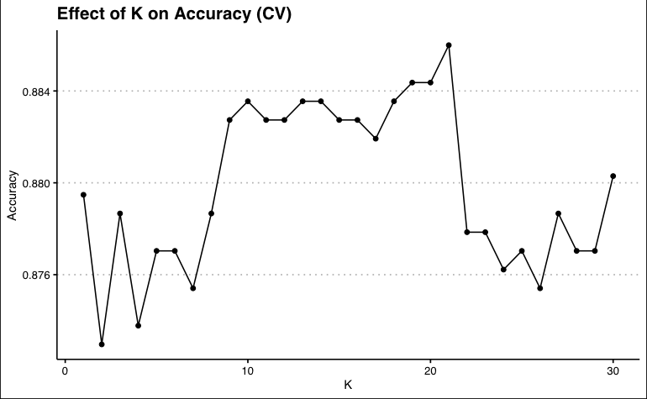
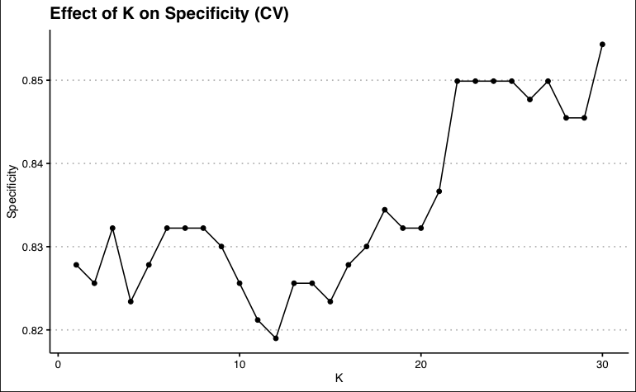
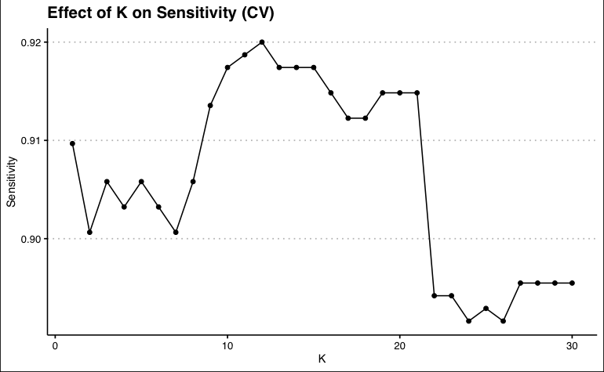
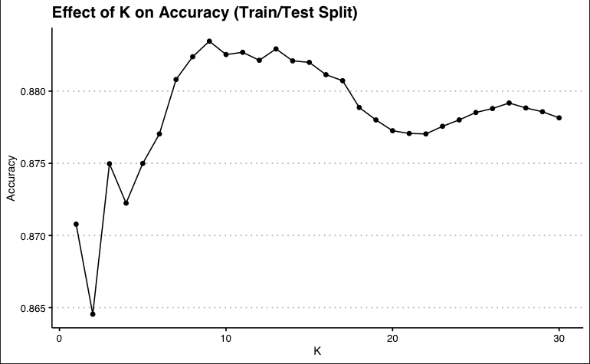
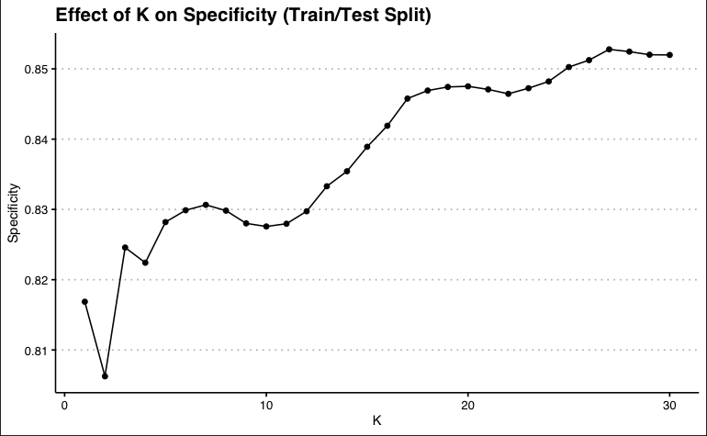
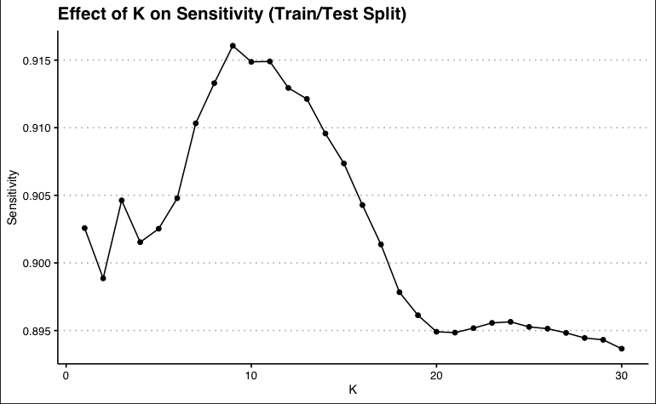
K = 21

Slide 10
Checking Performance
Model Statistics with k = 20
Accuracy | 0.92
Specificity | 0.92
Sensitivity | 0.92
The model was then validated with our validation data set.
Checking the model with our tuned k parameter, we observe good performance with the validation set.

Slide 11
Naive Bayes
Predicting with ABV and IBU
Accuracy | 87%
Specificity | 80%
Sensitivity | 90%
Similar Metrics to KNN

Slide 12
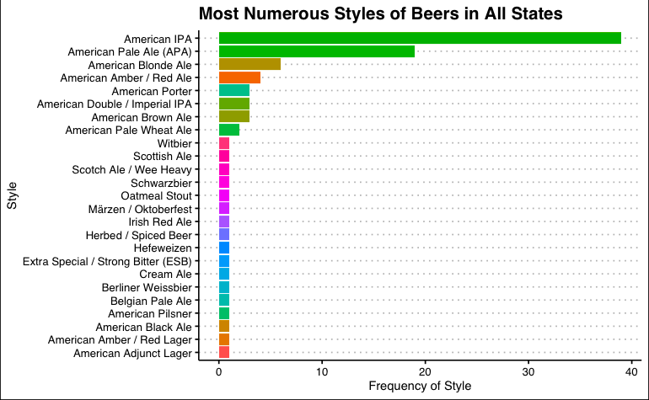
Market Analysis
American IPA is the most widely produced style of beer in the US

Slide 13
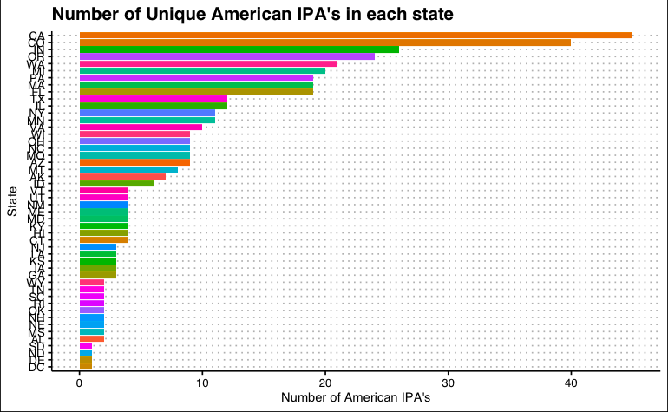
Market Analysis
Areas such as DC, North Dakota, South Dakota, and Delaware do not have many American IPA’s produced in that area.
Could be a huge opportunity!

Slide 14
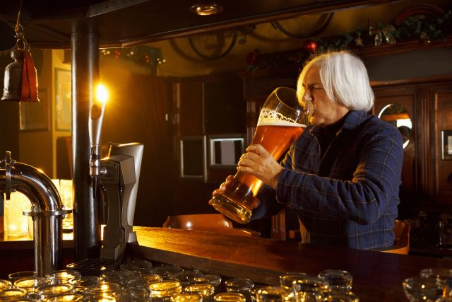
Tavin Weeda
tweeda@smu.edu
Jacob Gipson
gipsonj@smu.edu

